Slide 1




Free Body Diagram of Desk
w
$$F_{Equip}$$
c
M1
M2
$$F_{desk}$$
$$h_{max}$$
$$h_{min}$$

Slide 2




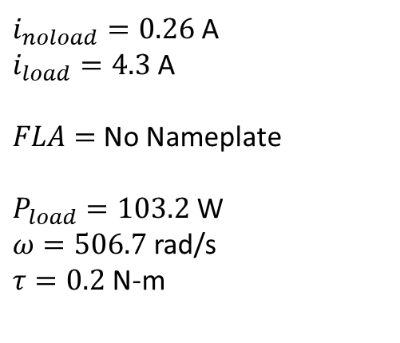

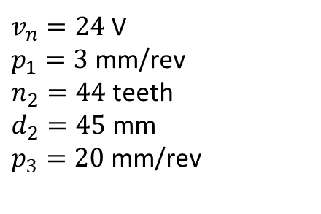




Single Motorized Leg System
$$R$$
$v_{n}=24$ V
$p_{1}=3$ mm/rev
$n_{2}=44$ teeth
$d_{2}=45$ mm
$p_{3}=20$ mm/rev
$$p_{1}$$
$$v(t)$$
$$p_{2}$$
$i_{noload}=0.26$ A
$i_{load}=4.3$ A
$FLA=$No Nameplate
$P_{load}=103.2$ W
$ω=506.7$ rad/s
$τ=0.2$ N-m
$$p_{3}$$
$$B$$

Slide 3
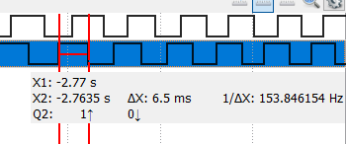
Encoder Measuring
Right leg motor running forward
[8:40 PM]
Nominal speed @24Vdc no load

